Slide 1
목재의 접착

Slide 2
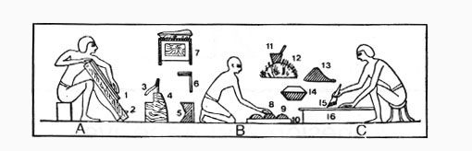
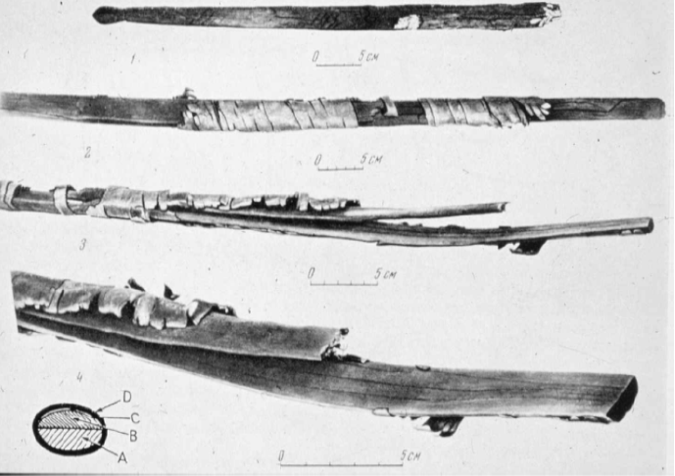

Slide 3
Relevance of Topic to Renewable Materials
70% of woods applications require some gluing
Fibers from agriculture crops need to be assembled into some structure requiring adhesion
Wood is bonded in over 70% of its applications (Hemingway 1989)
Diminishing high quality wood resource
  Straight, clear structural timber from sawing
  Increased use in composites
Use of agricultural fibers that inherently start as smaller constituents than wood
Move to adding value to agricultural residues
Composite from biological sources have been used since ancient Egypt and China

Slide 4
Importance of Adhesion
In order for two or more materials to perform as one material, as a composite, there needs to be an adhesive bond between these materials that allows them to deform as one. This is called continuity of strains. The adhesive, the adhesive bond, and the materials must be able to withstand external stresses and strains to perform as a composite.

Slide 5
Examples of Application
OSB, particleboard, plywood, glulams, wood-plastics, finishes and coatings, paper, furniture, laminate veneer lumber, laminated strand lumber, packaging, construction, and almost everywhere that wood is used.

Slide 6
Overview of Topics
Definitions of concepts related to adhesion
Adhesion mechanisms and theories
Thermoset adhesives for cellulosics
Surface preparation
Seizing/coupling agents for fibers and fillers in composites (thermoplastic or thermoset)

Slide 7
Key Terminology
Adhesion – the tendency for the surfaces’s dissimilar materials to cling together
Cohesion – molecular attraction by which the particles of similar bodies are united throughout the mass
Interface – the surface forming the common boundary between two materials in contact (2D)
Interphase – the volume around the interface that possesses properties unique from the joining materials

Slide 8
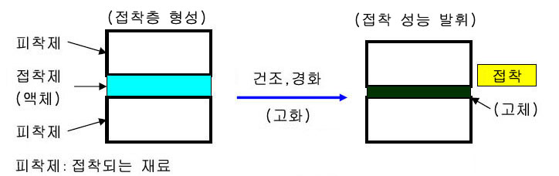

Slide 9
Practical Considerations
Adhesive
  Physical properties (shrinkage, molecular weight, etc.)
  Mechanical properties
Adherent (surface)
  Morphology
  Surface chemistry
Surface area
Application (the right glue for the correct application)
  End use
  Manufacturing
  Cost

Slide 10
Classes of Adhesives Used for Bonding Natural Fibers/Materials
Polyvinyl Acetates
Formaldehyde based
  Ureaformaldehyde, phenolics, resorcinol
Melamine
Tannin based
Protein based (casein, blood, soy)
Isocyanate based
  PMDI, urethanes, ureas
Others
  Epoxies, acrylics, hot-melt, starch
Notes:
This is a list of some of the most common wood adhesives, but it is not exhaustive or all inclusive. Many of these adhesive bond to natural surfaces using a variety of chemical and physical mechanisms.

Slide 11
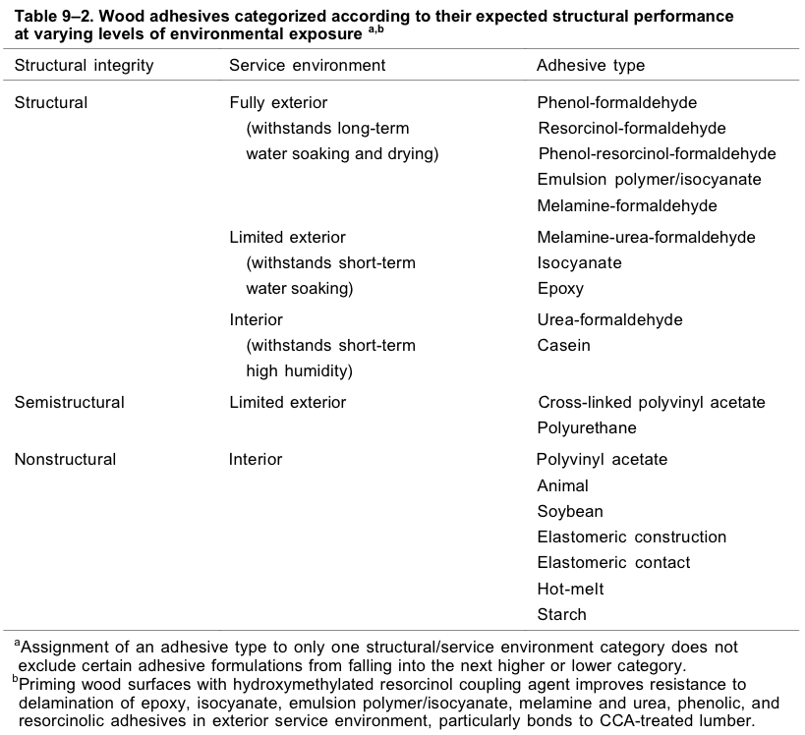
Adhesives Uses
From: The Woodhandbook (http://www.fpl.fs.fed.us/documnts/fplgtr/fplgtr113/ch09.pdf)
Notes:
Different adhesives types have varying end uses. The uses vary depending on adhesive properties, such as strength, toughness, and durability, and cost. Many of these properties depend on the bonding mechanism and the associated chemistry.

Slide 12
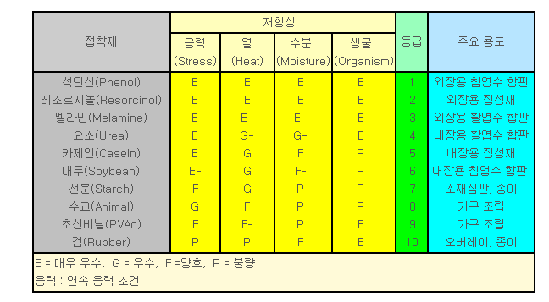

Slide 13
Adhesion Theories
Diffusion
Lifshitz-van der Waals interactions
Molecular interactions
Adsorption
Mechanical interlock
Chemical bonding
Electrostatic
Notes:
Diffusion - InterminglingChemical bonding - actual covalent bondsMolecular interactions - hydrogen bonding, secondary interactionsAdsorption - coating of a thin layer onto a surfaceLifshitz - dipole:dipole London dispersive (instantaneous dipole - dipole) induced dipole:induced dipoleMechanical interlock - nails and screwsElectrostatic - interaction between charged ions (metals)

Slide 14
Which Theories are Relevant…
To What Degree
Chemical bonding
Diffusion
Adsorption
Lifshitz-van der Waals interactions
Molecular interactions
Mechanical interlocking

Slide 15
Chemical Bonding
Formation of covalent bonds between adhesive and adherent
Formation of strong environmentally stable bonds
Water proof
Consume hydroxyls
Bond(kJ/mol)
C-C 348
C-N 293
C-O 358
C-F 485
C=C 614
Hydrogen 1-5
Notes:
There are several chemical bonds that are important to bonding wood that will impact the strength and durability of adhesion. Ideally, one tries to covalently link a material to the wood surface by forming any of the above bonds. However, hydrogen bonding is the most common binding mechanism. As one can observe, many hydrogen bonds must be formed to produce the equivalent strength to a covalent bond. Also, hydrogen bonds are not durable in the presence of moisture.

Slide 16
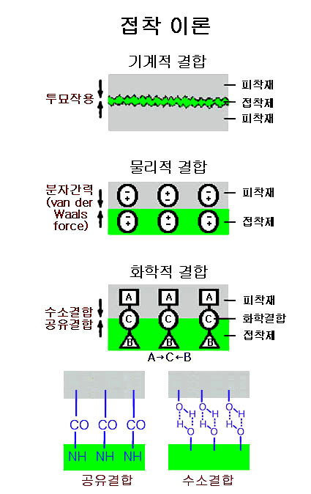
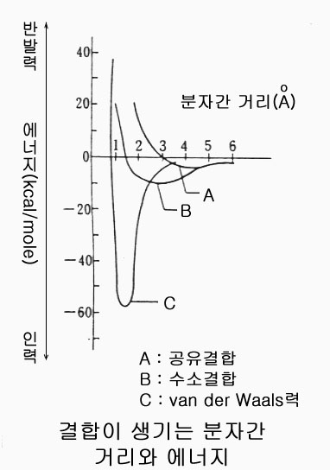

Slide 17
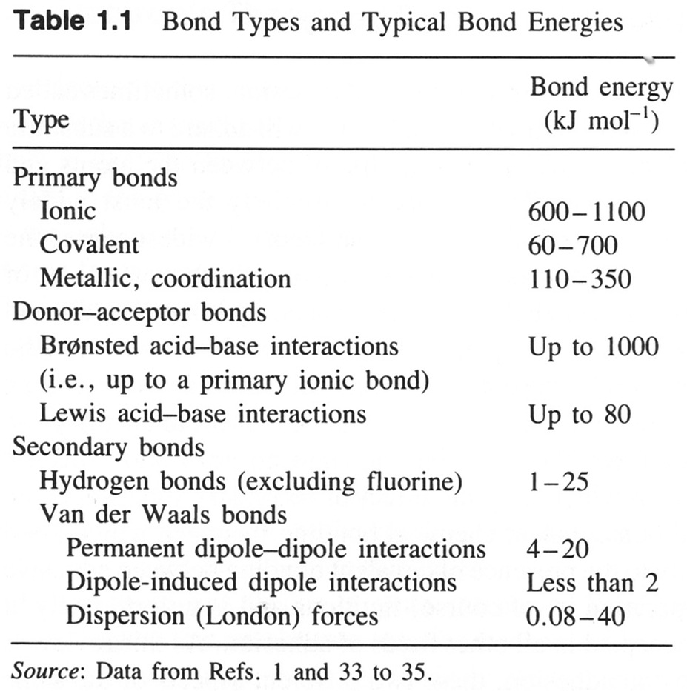
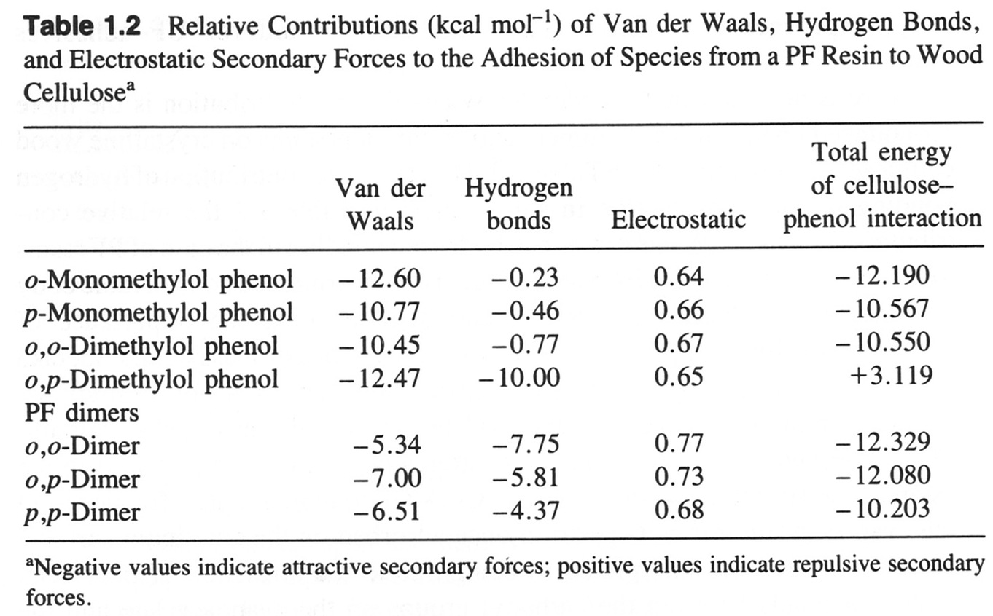
Strength of Adhesive Bonds
Source: Pizzi. Advanced Wood Adhesives Technology. Marcel Dekker. New York. 1994.
Notes:
Primary bonds are very strong, but they are not the most important bonds in wood adhesion. They have not been observed to exist either because they don’t exist or because they are present in such small quantity that they are beyond detection (Johns. The Chemical Bonding of Wood. In Wood Adhesives: Chemistry and Technology. Vol. 2. A. Pizzi Ed. Marcel Dekker. New York. 1989).

Slide 18
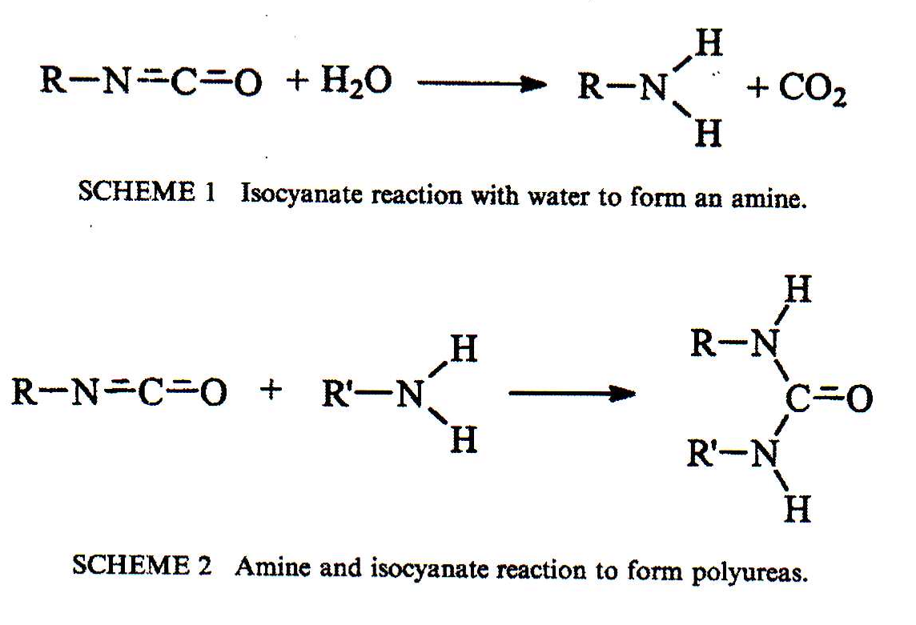
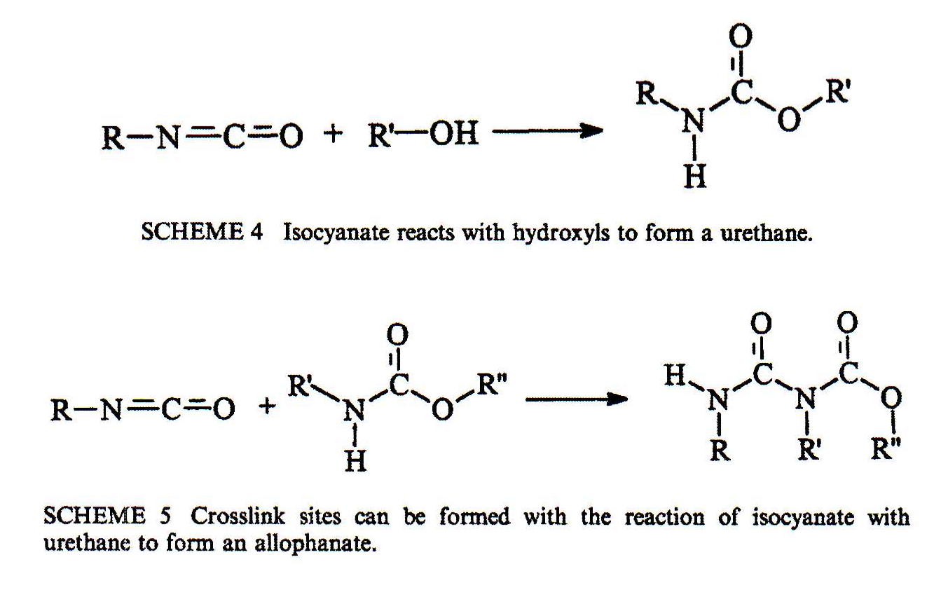
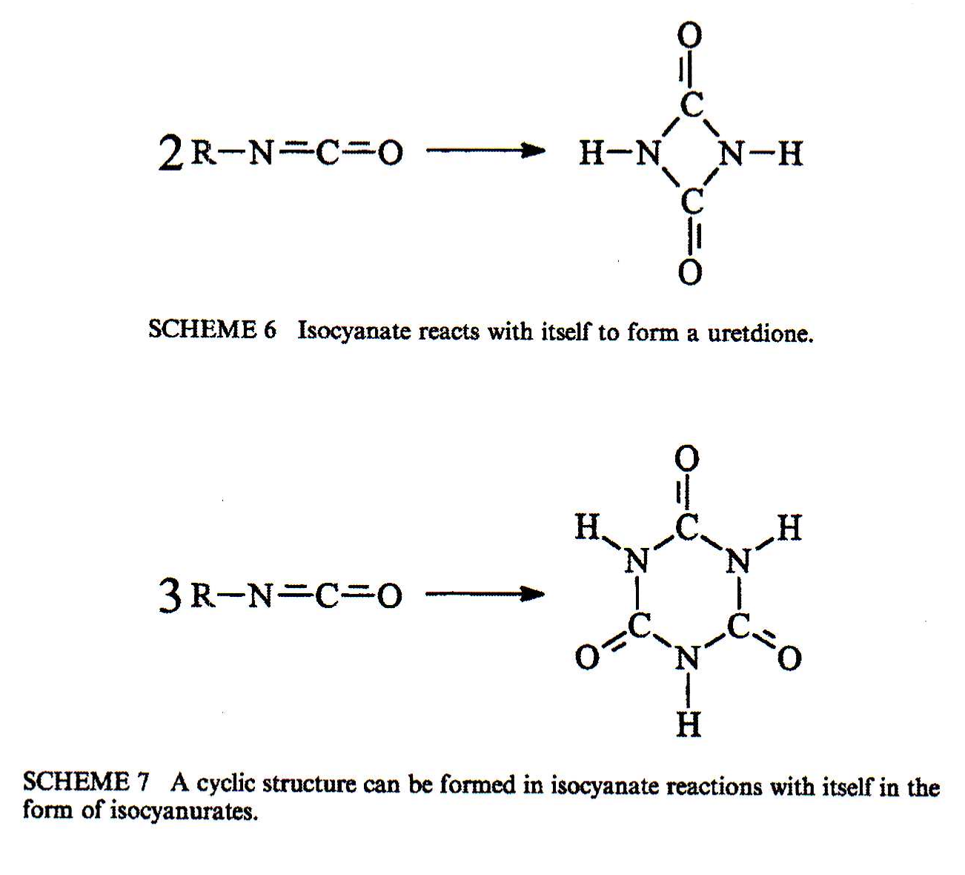
Example of Chemical Bonding
Harper et al. 2001
Notes:
Wood and isocyanate have the potential to form covalent chemical bonds. However, the pathway for the formation of polyureas is much more likely given the abundance of moisture present in wood. It is also thermodynamically preferred. To date, an isocyanate and wood chemical bond has not been discovered under realistic processing conditions.

Slide 19
Diffusion Theory
The entanglement of polymer chains in solution or melt
Polymer viscoelasticity
t characteristic relaxation time, t₀ is a small time step, N is the number of repeating units, a is an exponent (~3.2-3.4)
t > t the polymer chains are “frozen” or glassy
t < t the polymer chains flow
Notes:
Think of a bowl of spaghetti where the noodles become entangled. This could also be thought of as velcro, polymer chains may be hooked into the loops of other materials.

Slide 20
Diffusion Theory (cont.)
Self-diffusion
  Adhesive weaving into the adherent
  Entanglement/coupling, chain reptation (Brownian motion), cooperative movement
Inter-diffusion
  Both polymers cross the interface
Conditions
  Intimate contact
  Compatible (miscible) systems
  Above T_{g}
Solvent loss systems

Slide 21
Block Co-polymers
One strategy is to produce a molecule with different blocks along the backbone that are similar to each of the surfaces that one is trying to adhere. These ends can diffuse into the surface of one material adsorb on to that surface.
Diblock
Triblock
Pentablock
        Heptablock
*Eastwood, E. A. and M. D. Dadmun (2002). Macromolecules 35: 5069-5077.

Slide 22
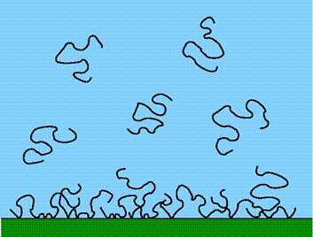
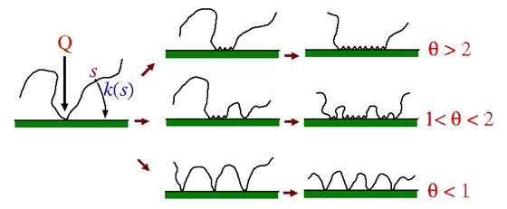
Surface density of “adsorbed layers”
Polymers assemble on surfaces out of solution or melt to a lower energy state
Density at the surface depends on the ergodicity of the space
Tails, loops are created
  Sites for “coupling” the matrix
  Ideal to have covalent bonds “chemisorption”
Optimal “sticker” density
B. O’Shaughnessy 2003

Slide 23
Lifshitz-van der Waals Interaction
We must consider the thermodynamic state of the surface. This
has an impact on the wetting or spreading of an adhesive on the
surface of a fiber.
γ = surface tension
G = Gibbs free energy
A = interface area
Equilibrium spreading pressure
W_{a} = work of adhesion
θ_{e} = equilibrium contact angle
S = surface V = volume L = liquid
Notes:
Dispersive forces have a critical role in the wetting, thus spread, of adhesive on a surface. This is important to assure intimate contact between the adhesive and adherent.

Slide 24
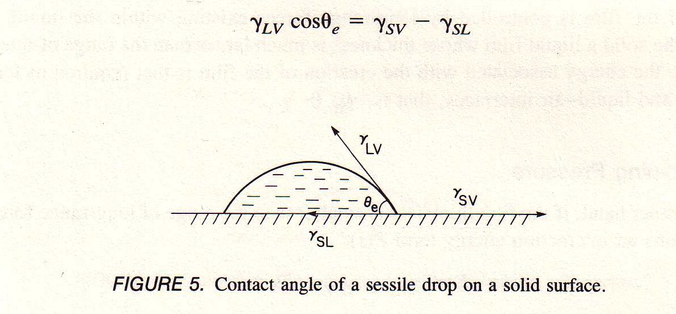
Lifshitz-van der Waals Interaction (cont.)
L.-H Lee 1991
If γ_{lv} < γ_{sv} and θ < 45° then good wetting is achieved.
Notes:
This illustrates the angle that a drop of liquid makes on a surface. Often, this angle changes with time and is asymmetric for natural materials. In example, a drop of water will wet along the grain of wood faster than across the grain.

Slide 25
Lifshitz-van der Waals Interaction (cont.)
Factors that impact surfaces
Aged wood surface
  Oxidation
  Higher C content
  Hydrophobic
Surfaces
  Extractives can dominate surface energy
  Silicates (wheat straw)
  Phelolics (wood)
  Basic (e⁻ characteristics)
Processing

Slide 26
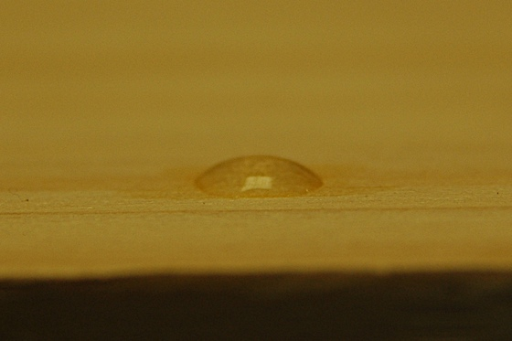
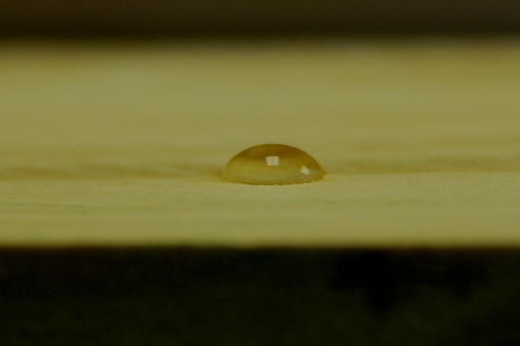
Examples of Wetting and Surface Properties
Figure 1: A water droplet on a freshly sanded tangential surface of ACQ treated Southern pine.
Figure 2: A water droplet on a freshly sanded tangential face of acetylated wood.

Slide 27
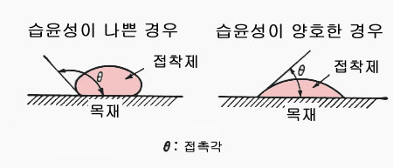

Slide 28
Molecular Interactions
(Non-dispersive Forces)
Non-dispersive forces
  Hydrogen, polar, acid-base
  Short range or specific interactions (<0.2 nm)
  Consist of a donor accepter pair
ΔH^{a-b} = enthalpy of formation
E → Electrostatic susceptibility
C → Covalent susceptibility
A → Acid
B → Base
f = enthalpy to free energy correction
less than or equal to 1
n^{a-b} = # of a-b pairs

Slide 29
Total Work of Adhesion
Total surface energy
  Polar (acid-base)
  Dispersive (London)
Dispersive
  Result from polarizability of electron orbitals
  Approximated by Lifshitz-van der Waals interactions
  Probed by nonpolar liquids to determine energies
Polar
  pH of biomaterials varies greatly
  Polar liquids to probe surface
  Swelling
  Varying probe liquids can result in varying surface energies

Slide 30
Mechanical Interlock
Hammer and nail approach
Glue gets stuck in pores
Not adhesive interaction
Stress transferred by friction or contact
Resins flow into pores and get physically stuck upon polymerizing, crystallizing, or becoming glassy
Must cross material interface
Notes:
This micrograph depicts a wood lumen filled with polypropylene.

Slide 31
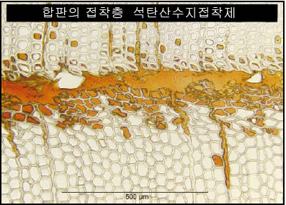
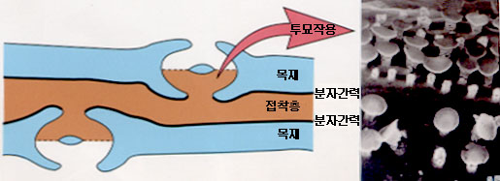

Slide 32
Electrostatic Interactions
Buildup of a charge on a surface caused by contact with other surfaces
  This is noticeable when own surface is highly resistive
Metals in contact
  Transfer of e⁻ across the interface (electrical double layer)
  Creates a force of attraction
  Can occur across some polymer metal interfaces
Ion – ion interactions
Little relevance to bio-based fibers and polymers since most are poor conductors and insulating materials
Although weak, the attractive force between a proton and electron is 40 times greater than that of gravity

Slide 33
Examples of Electrostatic Interactions
Plastic packaging on hands
Paper on CDs
Paints and coatings for metals

Slide 34
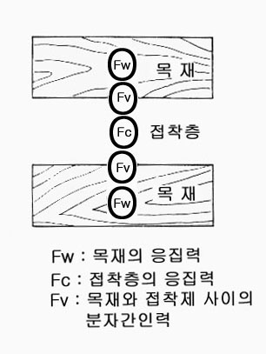
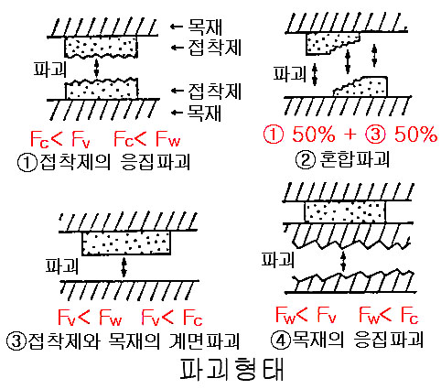

Slide 35
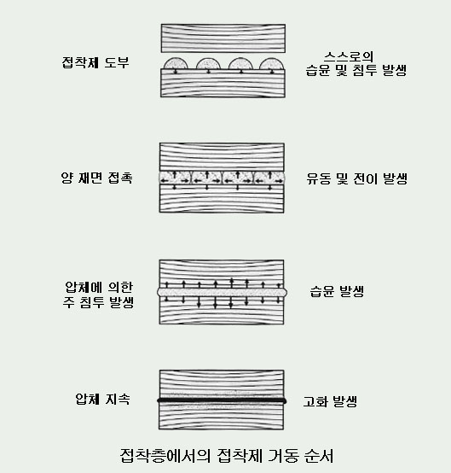

Slide 36
Adhesives Used for Natural
Fiber Composites
Thermoset
  Heat causes polymerization and cross-linking of the adhesive
  PMDI, UF, MUF, MF, PF, acrylics, epoxies
Thermoplastic
  Heat is applied to either melt (semi-crystalline) or raise the temperature above the glass transition temperature (amorphous) to allow a polymer to flow
  EVA, MAPP
Solvent loss
  A colloid or polymer is dispersed or dissolved in a solvent and the solvent evaporates away leaving a solid film
  Ethylene vinyl acetate (PVA) – latex based adhesive
Others
  Reactive systems (two part or other) – cyanoacrylates, epoxies, polyesters
  Radiation cure – acrylics and epoxies

Slide 37
Thermoset Adhesives
Formaldhyde based
  PF, UF, MF, MUF
Polyvinyl acetate (white wood glue)
Isocyanates
  Cyanoacrylates (Crazy and super glue), MDI (Gorilla glue), urethanes
Esters
Hot melt (thermoplastic)
Epoxies
Inorganics

Slide 38
Urea-Formaldehyde
An amino resin that is the polymeric condensation product of a reaction with formaldehyde and urea.
Most panel boards worldwide are made with UF
Advantages:
  Water solubility prior to cure, hard, flame resistant, clear, good thermal stability, can be tailored to a wide range of curing conditions, inexpensive compared to other resins
Disadvantages:
  Bond durability – caused by hydrolysis of the aminomethylenic bond
  Emits formaldehyde
  Wax is usually added to wood products to increase water resistance of the end product
Notes:
These resin have been used for many years with great success in interior applications at a low cost and high volume. However, new regulations are causing wood manufacturers to look for alternatives because of their high formaldehyde off-gassing levels.

Slide 39
Using UF
Applied by air atomization in a blender or blow-line
  Viscosity range = 30 – 300 centipoise
Reaction products and cure temperatures can be controlled by pH
  In general these are acid catalyzed at a pH ~4.2 (Maloney 1993)
  Curing temperatures 100 – 190°C
Cure time is dependent on many factors including furnish moisture, pH, molecular weight, free urea, and temperature. All of these factors can be controlled by the manufacturer.

Slide 40
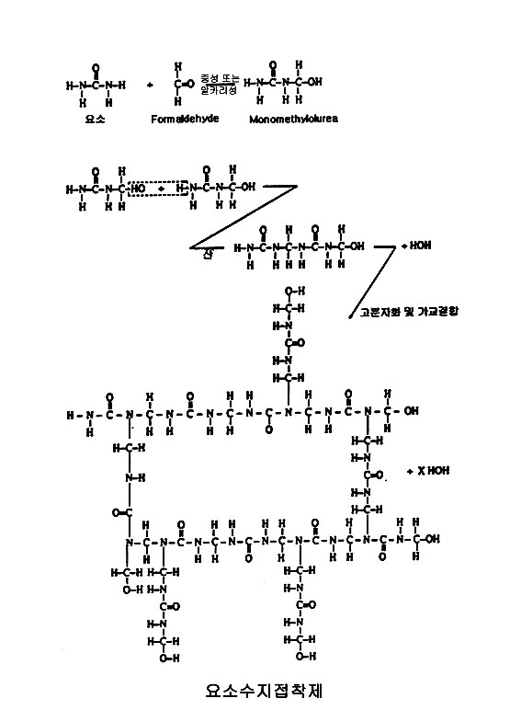

Slide 41
Melamine-Formaldehyde
Include MF (melamine-formaldehyde) and MUF (melamine-urea-formaldehyde)
Similar to UF, MF is formed by a condensation of melamine to formaldehyde. The amino group in melamine reacts completely with formaldehyde groups leading to complete methylolation. Up to six formaldehyde molecules may be attached (see Pizzi 1994).
Advantages
  More durable than UF, lower formaldehyde emissions, high tack with low viscosity (important for fiberboard), cure over a wide range of pH
Disadvantages
  More expensive than UF, less durable than phenol formaldehyde

Slide 42
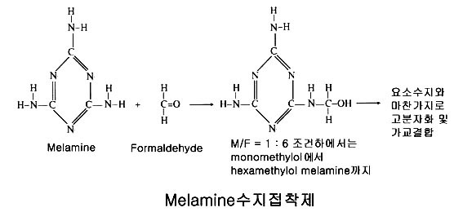

Slide 43
Phenol Formaldehyde
Polycondensation product of phenol and formaldehyde
First commercial polymer (bake-lite) and still of large commercial importance
Used in structural and external panels (OSB, Plywood, Parallam)
Advantages
  Non-conductive, heat resistant, water resistance, moderately inexpensive
Disadvantages
  Formaldehyde, brittle, distinctive redish-brown color, much more expensive than UF, need a higher temperature and longer cure time than UF or MUF

Slide 44
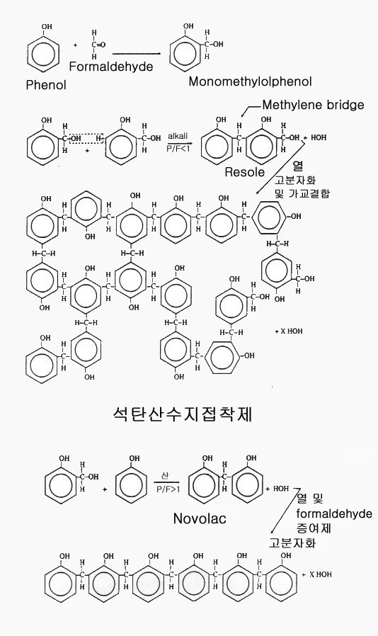

Slide 45
Resorcinol Resins
Resorcinol resins may be a combination of resorcinol and PF resins. They are two-part systems that are mixed with a catalyst to cure at room temperature. They are primarily used in laminated beams, finger joints, and structural applications.
Advantages
  Very resistant to moisture, strong bonds, long-term durability
Disadvantages
  Can have long curing times, expensive, reddish-brown color

Slide 46
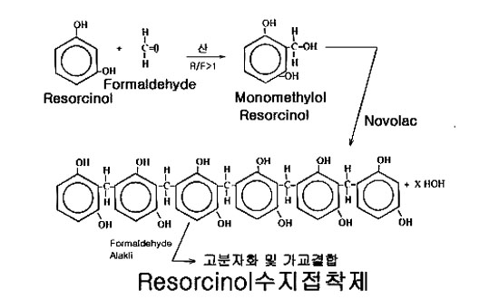

Slide 47
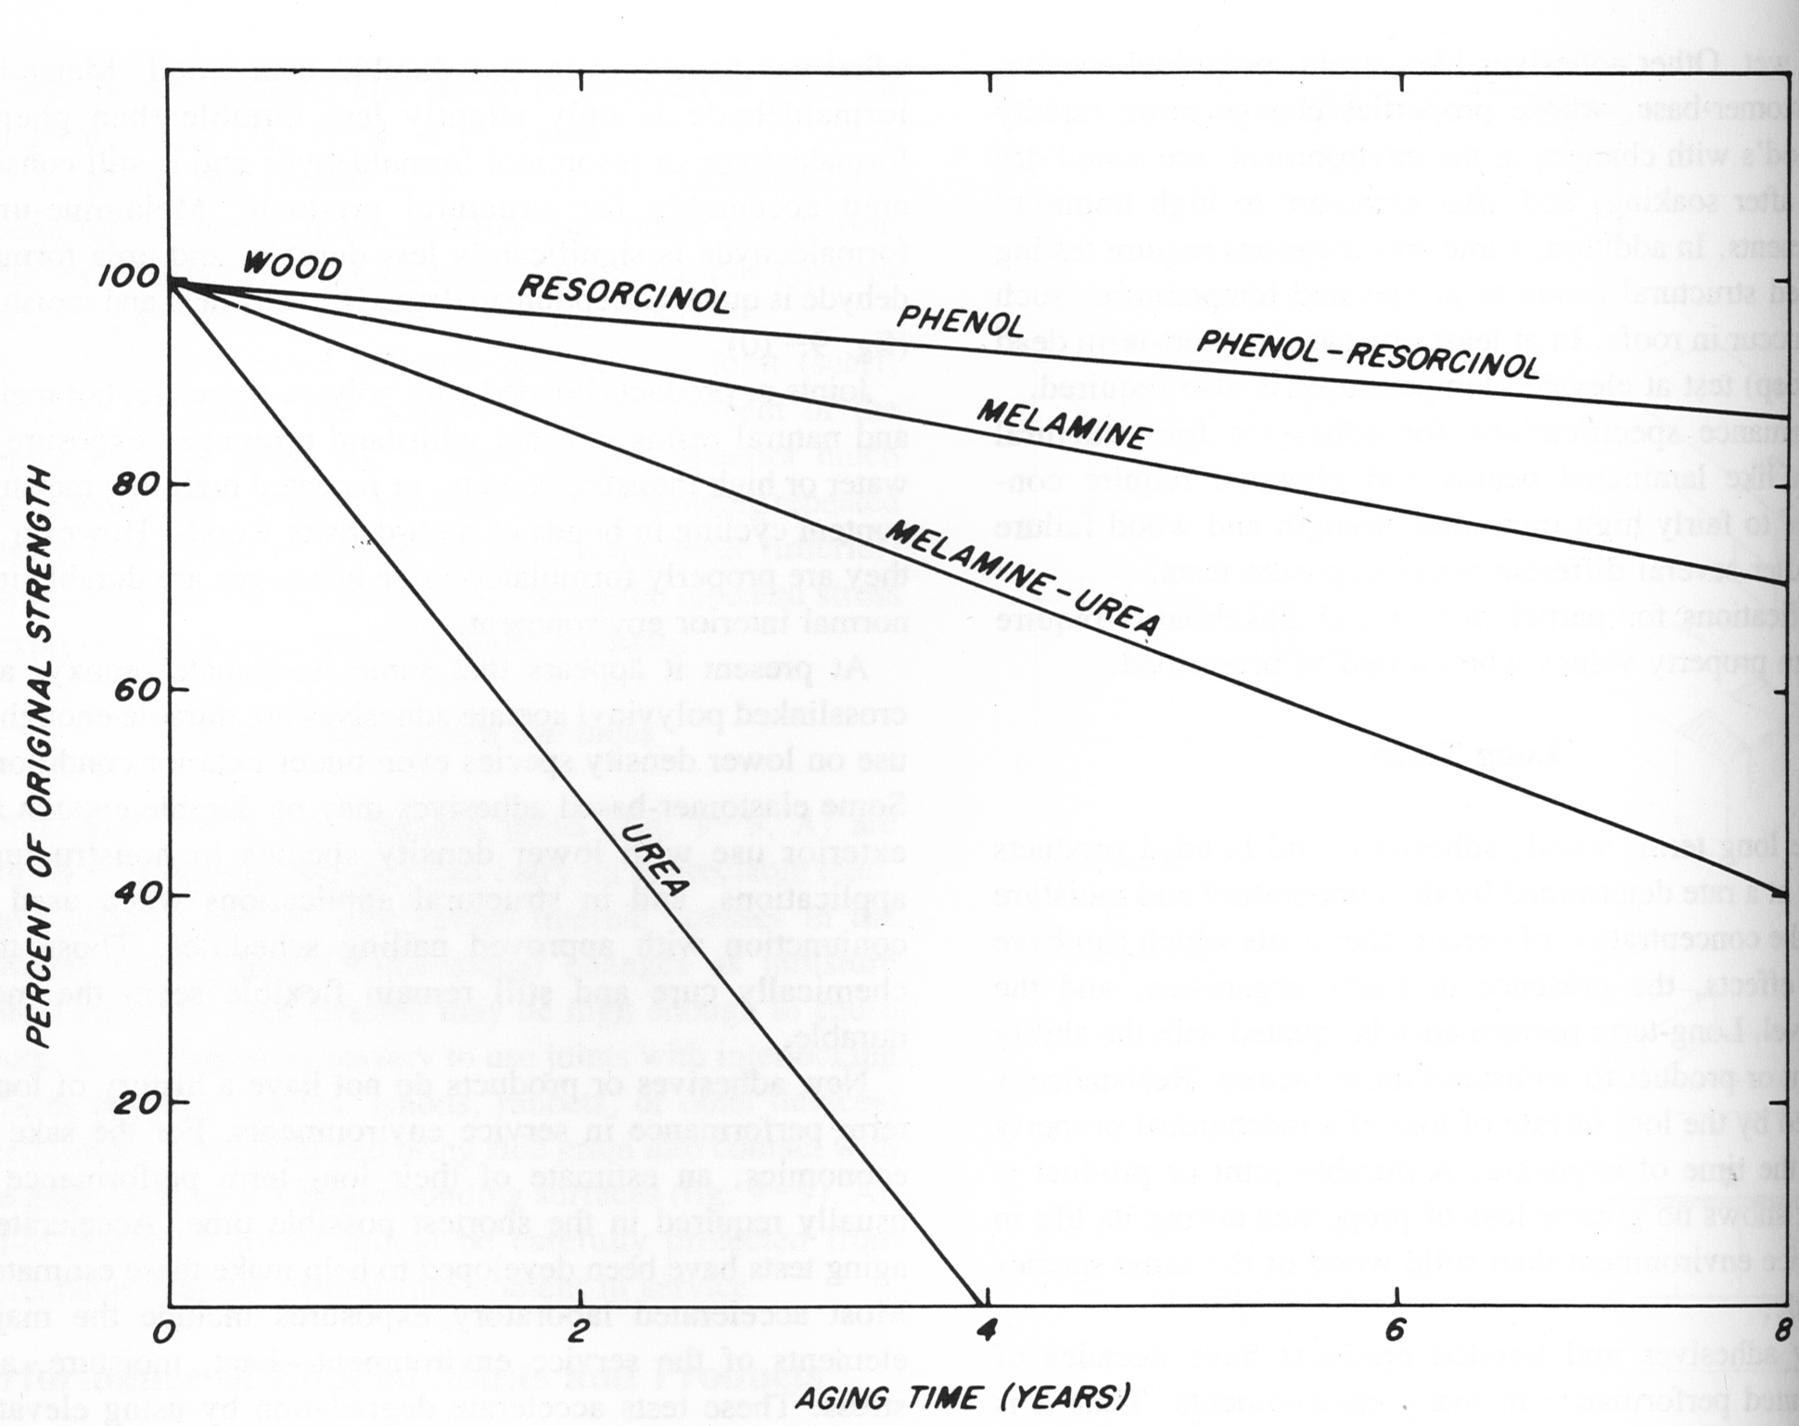
Adhesive Durability
This schematic illustrates the relative rate of degradation for some wood adhesives.
From: The Woodhandbook (http://www.fpl.fs.fed.us/documnts/fplgtr/fplgtr113/ch09.pdf)

Slide 48
Isocyanates
Primary reaction is isocyanate and water to form an amine and subsequently a poly urea
Used in structural, exterior panels that are strong and moisture resistant
Advantages
  100% solids, no formaldehyde, wets wood better than PF, does not introduce excess moisture, durable and strong bonds, foams
Disadvantages
  Much more expensive than formaldehyde based adhesives, sensitizing agent, foams, bonds metal

Slide 49
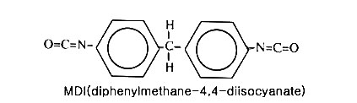


Slide 50
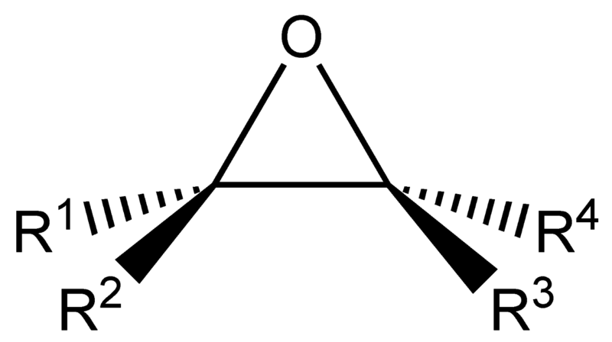
Epoxides
Many different chemicals that consist of an epoxide ring that reacts with an amine or free radical to cure with time, heat, or ionizing radiation. Usually, epoxies are cured as two part systems with a resin and a hardener.
Advantages
  Good adhesion to a wide range of materials depending on formulation, a wide range of formulations are available, reacts completely with little to no VOC emissions, moisture resistant
Disadvantages
  Not a lot of information of the efficacy and durability of wood bonds, some components of common epoxies are carcinogens (bisphenol-A), expensive
Current uses include repairing glulams, molded wooden boats, bonding wood to other materials
Image from: http://en.wikipedia.org/wiki/File:Epoxide_generic.png

Slide 51
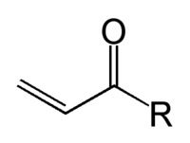
Acrylics
Many different chemicals that consist of an acrylate or methacrylate group that reacts with a hardener or free radical to cure with time, heat, or ionizing radiation.
Advantages
  Good adhesion to a wide range of materials depending on formulation, a wide range of formulations are available, moisture resistant, heat resistant, methacrylates make a stiffer, but often harder to cure bond and are more expensive
Disadvantages
  Not a lot of information of the efficacy and durability of wood bonds, may off-gas harmful vapors, expensive
Currently, acrylics have very limited use in wood, but there has been a lot working on impregnating wood for flooring, counter tops and other application. There is a large potential for its utility in radiation cure in wood products.

Slide 52
Protein Based
Made from proteins from animals, blood, casein (milk), and soy
  Usually mixed with water and lime and cure at room temperature most commonly
New soy adhesives are being combined with formaldehyde based adhesives to reduce VOC’s and use a renewable feedstock
Advantages
  High dry strength, good thermal resistivity
Disadvantages
  Poor moisture and biological resistance
Still used in interior doors and furniture because of good fire performance

Slide 53
MAPP
Notes:
Maleic anhydride polypropylene is an adhesion promoter used in wood-plastic composites. It has shown a great deal of efficacy in promoting better adhesion between wood (also other natural fibers) and polyolefins.

Slide 54
Ethylene Vinyl Acetate (EVA)
A common, nontoxic, thermoplastic (hot melt) adhesive used in edge-banding, packaging, paper and plastic overlays, patching, and furniture assemble. It bonds rapidly and can fill gaps.
Advantages
  Non-toxic, easy application, moisture resistant, inexpensive
Disadvantages
  Low strength, poor creep performance, poor thermal stability, low penetration, requires special equipment

Slide 55
Poly (vinyl) Acetate (PVA)
Solvent loss system that is usually water based that can be cured at room temperature under pressure. Solvent loss systems need intimate contact by applying pressure to form adhesive bonds.
Advantages
  Cheap, high dry strength, non-toxic (can be used in food contact applications), can be combined with cross-linking agents and catalysts to increase durability, dries clear to varying color
Disadvantages
  Low moisture resistance (cross-linking improves this, but makes it more toxic and expensive), low heat resistance
Used in many furniture, molding, doors and architectural applications. It is commonly referred to as carpenters or wood glue

Slide 56
Silanes and Surface Modifications
Try to marry dissimilar materials
  Polymer backbone similar to matrix
  Polar component similar to adherent
Silanes (thermoset or thermoplastics)
Anhydrides (Polyolefin co-polymers)
Hydroxymethylated resorcinol (HMR)
  Effective with traditional wood thermosets

Slide 57
Summary and Review Questions
Relevant adhesion theories
Adhesives
Surface considerations
Applications

