Slide 1





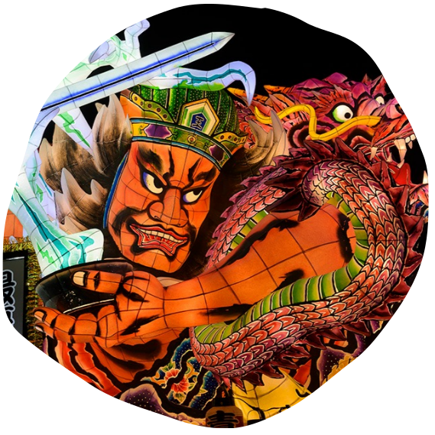




Slide 2

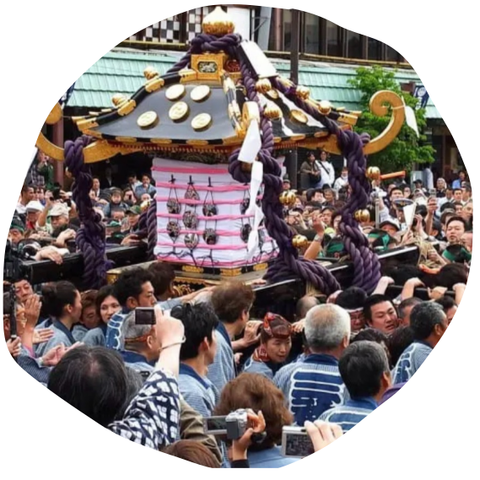






Slide 3

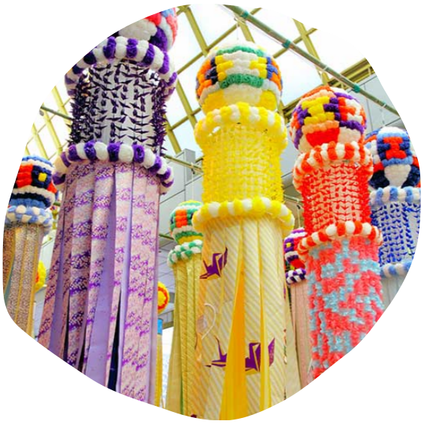







Slide 4

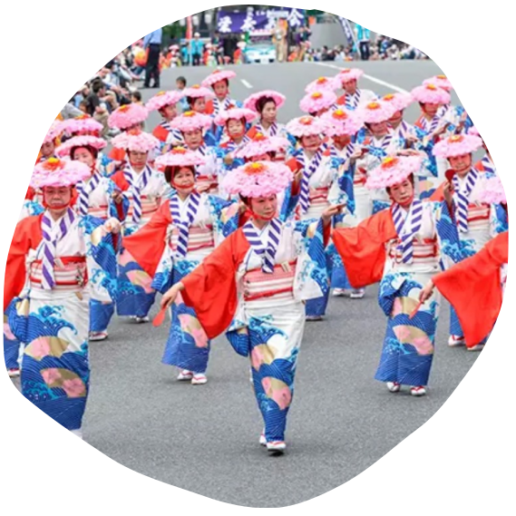





Slide 5

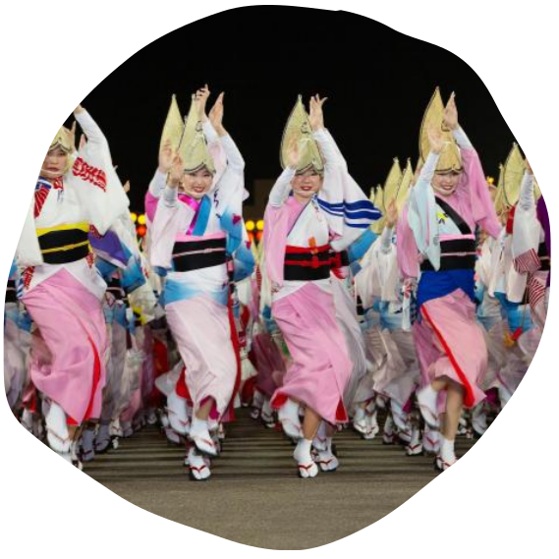






Slide 6

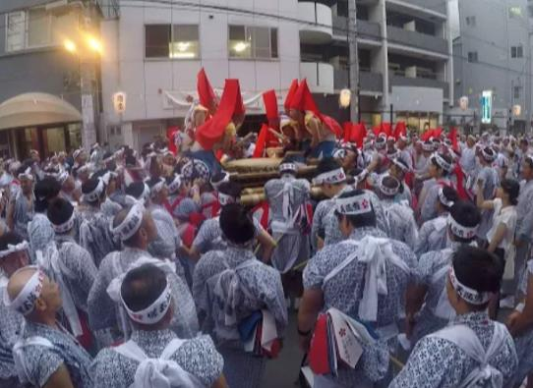



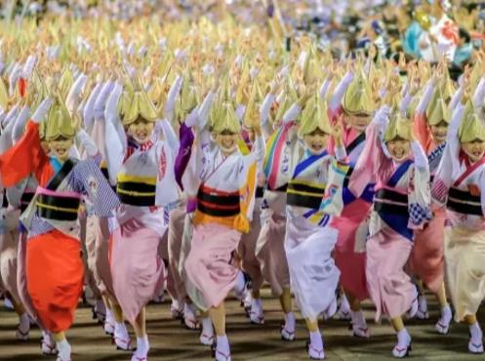




Slide 7




간다마츠리 https://ja.wikipedia.org/wiki/%E7%A5%9E%E7%94%B0%E7%A5%AD https://livejapan.com/ko/in-tokyo/in-pref-tokyo/in-akihabara/spot-lj0013834/
http://trcskim.pe.kr/html/jaryo/maturi.htm https://ja.wikipedia.org/wiki/%E7%A5%9E%E7%94%B0%E6%98%8E%E7%A5%9E
기온마츠리 https://ja.wikipedia.org/wiki/%E7%A5%87%E5%9C%92%E7%A5%AD https://ja.wikipedia.org/wiki/%E5%85%AB%E5%9D%82%E7%A5%9E%E7%A4%BE
http://t3.gstatic.com/licensed-image?q=tbn:ANd9GcR7byWyEY611l-3eSx8lGXqx3SdVB7K7HsVXg06KepA98VxKjd1PW1654QreYag08GB
https://www.travel.co.jp/guide/article/33578/ https://tateyamacity.com/archives/21484
http://www.digistyle-kyoto.com/kanko/gionmatsuri09/cal_event/yamaboko0717.html
텐진마츠리 https://ja.wikipedia.org/wiki/%E5%A4%A9%E7%A5%9E%E7%A5%AD https://ja.wikipedia.org/wiki/%E5%A4%A7%E9%98%AA%E5%A4%A9%E6%BA%80%E5%AE%AE
https://osakatemmangu.or.jp/saijireki/tjm https://ikedanaoya.com/events/%e5%a4%a9%e7%a5%9e%e7%a5%ad%e5%a5%89%e7%b4%8d%e8%8a%b1%e7%81%ab%e3%81%ae2022%e5%b9%b4%e3%81%ae%e6%97%a5%e7%a8%8b%e3%82%84%e8%a6%8b%e6%89%80%e3%80%81%e6%9c%89%e6%96%99%e5%b8%ad%e3%81%ae%e6%9c%89/
네부타마츠리 https://www.nebuta.jp
산자마츠리 https://matcha-jp.com/jp/4257
다나바타마츠리 https://travel.rakuten.co.jp/mytrip/trend/tanabata
하카타돈타쿠 https://gogen-yurai.jp/hakatadontaku/
아와오도리 https://www.city.tokushima.tokushima.jp/kankou/awaodori/index.html

Slide 8









